Slide 1
Chapter 10: Capacitors

Slide 2
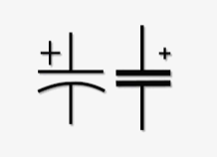
10.1 Introduction
Like the resistor, capacitor is a two-terminal device, but its characteristics are totally different from those of a resistor.
An ideal capacitor, however, stores the energy delivered to it in a form that can be returned to the system.

Slide 3
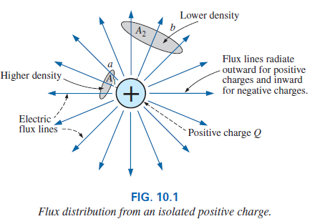

10.2 The Electric Field
Consider the electric field that exists in the region around any charged body. This electric field is represented by electric flux lines, which are drawn to indicate the strength of the electric field at any point around the charged body.
The denser the lines of flux, the stronger the electric field.
In Fig. 10.1, the electric field strength is stronger in region a than region b because the flux lines are denser in region a than b.
The symbol for electric flux is the Greek letter ψ (psi). The flux per unit area (flux density) is represented by the capital letter D and is determined by

Slide 4
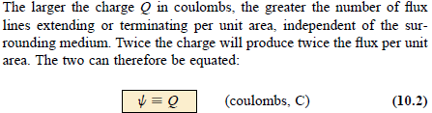
10.2 The Electric Field

Slide 5
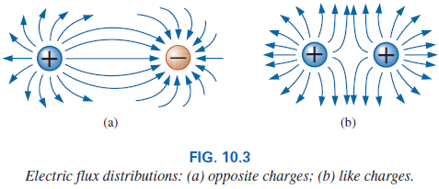
10.2 The Electric Field
For two charges of similar and opposite polarities, the flux distribution would appear as shown in Fig. 10.3.
In general, electric flux lines always extend from a positively charged body to a negatively charged body, and never intersect.

Slide 6
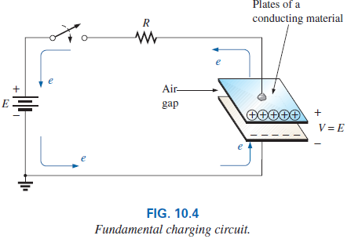
10.3 Capacitance
Now consider two parallel plates of a conducting material such as aluminum (Al) separated by an air gap have been connected through a switch and a resistor to a battery.
If the parallel plates are initially uncharged and the switch is left open, no net positive or negative charge will exist on either plate.

Slide 7
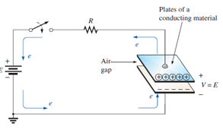
10.3 Capacitance
The instant the switch is closed, electrons are drawn from the upper plate through the resistor to the battery’s positive terminal. This action creates a net positive charge on the top plate.
Electrons are being repelled by the negative terminal through the lower conductor to the bottom plate at the same rate they are being drawn to the positive terminal.
This transfer of electrons continues until the potential difference across the parallel plates is exactly equal to the battery voltage.
The final result is a net positive charge on the top plate and a negative charge on the bottom plate.
It is important to note that the entire flow of charge is through the battery and resistor—not through the region between the plates as they are acted as an open circuit.
This element, constructed simply of two conducting surfaces separated by the air gap, is called a capacitor.

Slide 8
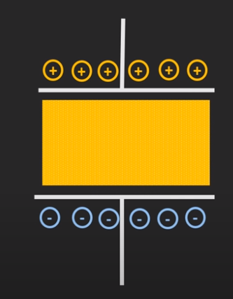
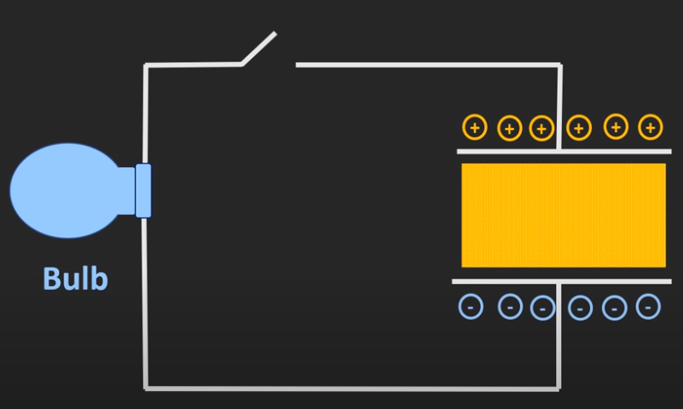
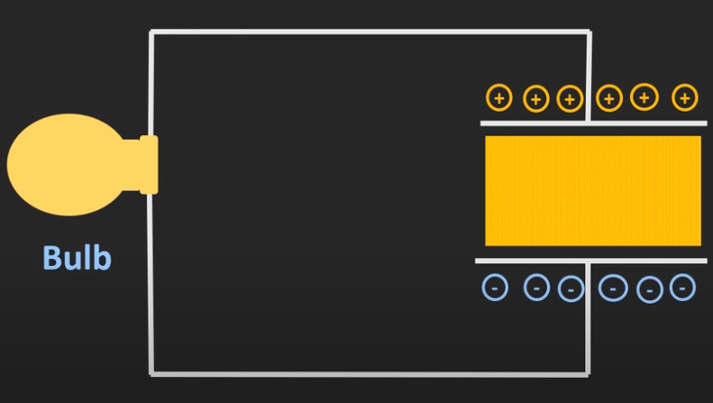
Capacitor
If we remove the voltage source, then also the charges that are developed across the two plates remain as it is.
Unless we apply the conducting path to this capacitor, the charges that are developed across the two plates remain as it is.
Whenever the switch is closed, the electrons from the bottom plate will get attracted towards the top plate.
In this way there will be a transfer of charge in the form of flow of current –bulb will work.
This process continues until both the plates become electrically neutral.

Slide 9
Capacitance
Capacitance is a measure of a capacitor’s ability to store charge on its plates—in other words, its storage capacity.
In addition, the higher the capacitance of a capacitor, the greater the amount of charge stored on the plates for the same applied voltage.
A capacitor has a capacitance of 1 Farad if 1 Coulomb of charge (6.242 X 10¹⁸ electrons) is deposited on the plates by a potential difference of 1 volt across the plates.
The Farad, too large a measure of capacitance for most practical applications, so the micro-farad (10⁻⁶) or picofarad (10⁻¹²) is more commonly used.

Slide 10
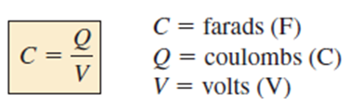

Capacitance
The relationship between the applied voltage, the charge on the plates, and the capacitance level is defined by the following equation:
for the same voltage (V), the greater the charge (Q) on the plates, the higher the capacitance level (C).
The product relationship that the higher the capacitance (C) or applied voltage (V), the greater the charge on the plates.

Slide 11
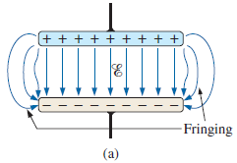
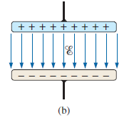

10.3 Capacitance
A cross-sectional view of the parallel plates is shown with the distribution of electric flux lines in Fig. 10.6(a). The number of flux lines per unit area (D) between the two plates is quite uniform.
At the edges, the flux lines extend outside the common surface area of the plates, producing an effect known as fringing. This effect, which reduces the capacitance somewhat, can be neglected for most practical applications.

Slide 12

Electric Field Strength
The electric field strength between the plates is determined by the voltage across the plates and the distance between the plates as follows:
The equation for the electric field strength is determined by two factors only: the applied voltage and the distance between the plates.
The electric field strength does not depend on the charge on the plates, nor does the size of the capacitor or the plate material.

Slide 13
10.3 Capacitance
Many values of capacitance can be obtained for the same set of parallel plates by the addition of certain insulating materials (dielectric/insulators) between the plates.
The purpose of the dielectric, therefore, is to create an electric field to oppose the electric field set up by free charges on the parallel plates.
For this reason, the insulating material is referred to as a dielectric, di for “opposing” and electric for “electric field.”
In either case—with or without the dielectric—if the potential across the plates is kept constant and the distance between the plates is fixed, the net electric field strength within the plates must remain the same, as determined by the equation ξ = V/d.

Slide 14
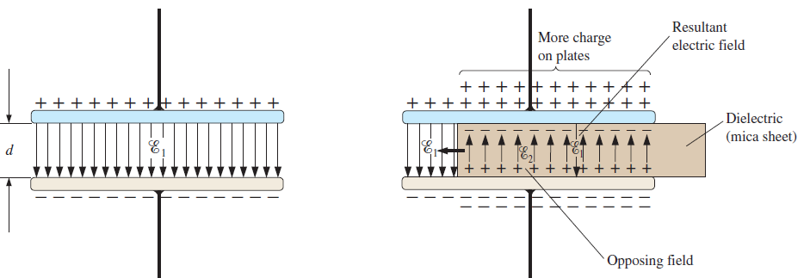

The net electric field between the plates would decrease with insertion of the dielectric for a fixed amount of free charge on the plates.
To compensate and keep the net electric field equal to the value determined by V and d, more charge must be deposited on the plates. This additional charge for the same potential across the plates increases the capacitance, as determined by the following equation:
For different dielectric materials between the same two parallel plates, different amounts of charge will be deposited on the plates.

Slide 15
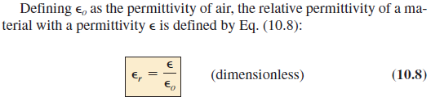
10.3 Capacitance
Different materials placed between the plates establish different amounts of additional charge on the plates. All, however, must be insulators and must have the ability to set up an electric field within the structure.
The term permittivity is applied as a measure of how easily a material “permits” the establishment of an electric field in the material.
The relative permittivity (or dielectric constant) compares the permittivity of a material to that of air.

Slide 16
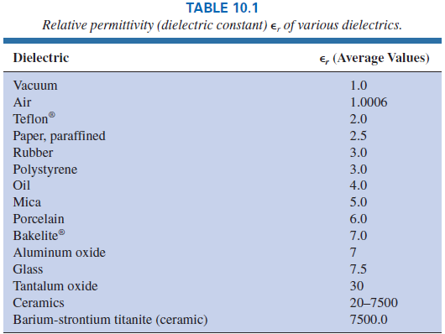
10.3 Capacitance

Slide 17
10.3 Dielectric Strength
For every dielectric there is a potential that, if applied across the dielectric, will break the bonds within the dielectric and cause current to flow.
The voltage required per unit length (electric field intensity) to establish conduction in a dielectric is an indication of its dielectric strength and is called the breakdown voltage.
When breakdown occurs, the capacitor has characteristics very similar to those of a conductor.

Slide 18
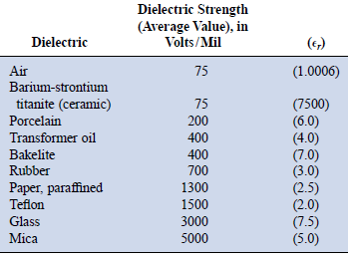
10.3 Dielectric Strength
The average dielectric strengths for various dielectrics are tabulated in volts/mil in Table 10.2 (1 mil = 0.001 in.).
The relative permittivity appears in parentheses to emphasize the importance of considering both factors in the design of capacitors.

Slide 19
10.4 Capacitors (Basic Construction)
Basic components of a capacitor are: conductive plates, separation, and dielectric.
However, the question remains, How do all these factors interact to determine the capacitance of a capacitor?
Larger plates permit an increased area for the storage of charge, so the area of the plates should be in the numerator of the defining equation.
The smaller the distance between the plates, the larger the capacitance so this factor should appear in the denominator of the equation.
Finally, since higher levels of permittivity result in higher levels of capacitance, the factor ε should appear in the numerator of the defining equation.

Slide 20
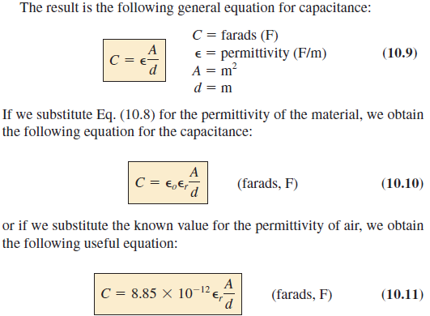
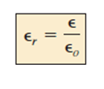
10.4 Capacitors (Basic Construction)

Slide 21
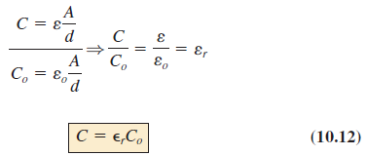
10.4 Capacitors (Basic Construction)
Most capacitors are in the μF, nF, or pF range, not the 1 F or greater range.
If we form the ratio of the equation for the capacitance of a capacitor with a specific dielectric to that of the same capacitor with air as the dielectric, the following results:

Slide 22
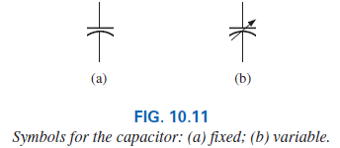
10.4 Capacitors Types of Capacitors
Like resistors, all capacitors can be included under either of two general headings:
fixed or
variable.
Symbols:
The curved line represents the plate that is usually connected to the point of lower potential.

Slide 23
10.4 Capacitors Standard Capacitor Values
The most common capacitors use the same numerical multipliers encountered for resistors.
The vast majority are available with 5%, 10%, or 20% tolerances. There are capacitors available, however, with tolerances of 1%, 2%, or 3%, if you are willing to pay the price.
Typical values include 0.1 μF, 0.15 μF, 0.22 μF, 0.33 μF, 0.47 μF, 0.68 μF; or 1 μF, 1.5 μF, 2.2 μF, 3.3 μF, 4.7 μF, 6.8 μF; and 10 pF, 22 pF, 33 pF, 100 pF; and so on.

Slide 24
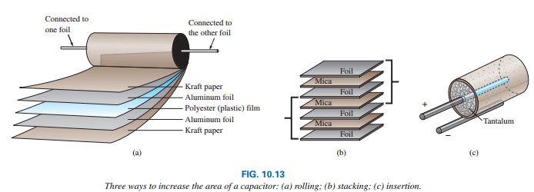
What factors influence which dielectric is used?
The following factors greatly influence which dielectric is used:
The level of capacitance desired
The resulting size
The requirements for packaging: rolling, stacking and insertion
Temperature sensitivity
Working voltage

Slide 25
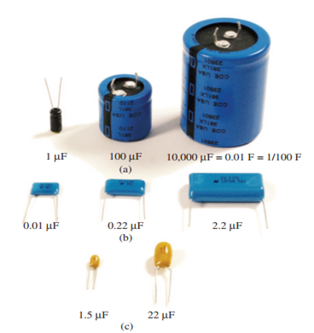

Types of Capacitors
In general, for the same type of construction and dielectric, the larger the required capacitance, the larger the physical size of the capacitor.
Generally there are 3 types:
Electrolytic capacitors
Film, polyester, foil, or Teflon capacitors
Ceramic capacitors (often called disc capacitors

Slide 26
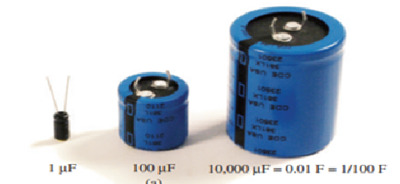
Electrolytic capacitors
The electrolytic capacitors are usually easy to identify by their shape.
Offer some of the highest capacitance values available, although their working voltage levels are limited.
Typical values range from 0.1 mF to 15,000 mF, with working voltages from 5 V to 450 V.

Slide 27
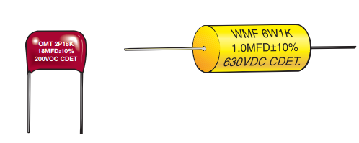
Film, polyester, foil or Teflon capacitors
Film, polyester, foil, polypropylene or Teflon capacitors packaged in a rolling or stacking process.
The resulting shape can be either round or rectangular, with two leads.
The typical range for such capacitors is 100pF to 10 mF
Working voltages can extend from a few volts to 2000 V, depending on the type of dielectric.

Slide 28
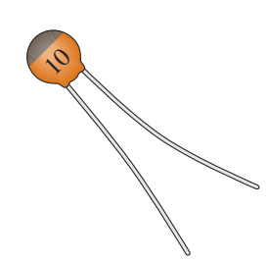
Ceramic capacitors
Ceramic capacitors (often called disc capacitors) use a ceramic dielectric to utilize the excellent permittivity values and high working voltages associated with a number of ceramic materials.
Stacking can also be applied for packaging.

Slide 29
Thank You

